Slide 1

B.L.D.E.A’s V.P DR. P.G. Halakatti College
of Engineering and Technology
DBMS MINI PROJECT
Topic Name: Car Test Drive Management
System
TEAM MEMBERS:
USN :
Aishwarya Biradar
Deepika Patil
Kavyareddi Harennavar
2BL20CS009
2BL20CS036
2BL20CS043

Slide 2

INDEX
INTRODUCTION
ER AND SCHEMA DIAGRAM
FUNCTIONALITIES
TECHNOLOGY USED
CONCLUSION
REFERNCE

Slide 3

INTRODUCTION
A car test drive management system is a database-driven software application that helps car dealerships and rental companies manage the scheduling, tracking, and reporting of test drives for their vehicles. The system typically stores information about the vehicles, customers, and test drives in a database, and provides a user interface for adding, editing, and viewing this information.
Car test drive management system can help dealerships and rental companies streamline and automate the process of scheduling and tracking test drives, and provide valuable insights into customer preferences and vehicle performance. By using a database management system (DBMS) to store and manage the data, the system can also ensure that the data is accurate, consistent, and secure.

Slide 4
E R DIAGRAM
ER diagrams help to explain the logical structure of databases.ER diagram are created based on three basic concepts: entities, attributes and relationships. ER diagrams contain different symbols that use rectangles to represent entities, ovals to define attributes and diamond shapes. At first look, an ER looks very similar to the flowchart. However, ER diagram includes many specialized symbols, and its meanings make this model unique. The purpose of ER Diagram is to represent the entity framework infrastructure.
ER diagram of Car Test Drive Management System illustrates key information about the Car Test Drive including entities such as admin, user, car, car design, test slot, feedback. It allows for understanding the relationships between entities.

Slide 5
password
name
model
rating
comment
Login_id
mobile
1
n
Admin
reads
feedback
1
n
gives
reads
company
Login_id
password
type
Car_id
n
1
n
1
car
reads
user
price
m
1
l
model
reads
mobile
has
name
n
length
n
Seating_capacity
Car_design
Test_slot
color
width
fuel
mileage
location

Slide 6
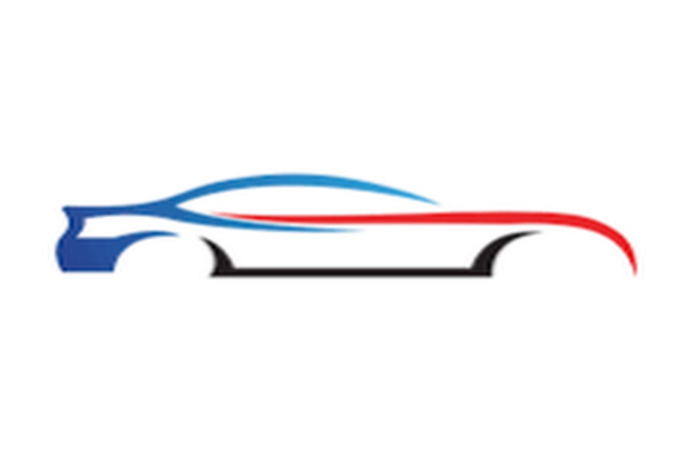

SCHEMA DIAGRAM

Slide 7
Admin
Login_id | Password | Name | mobile
user
Login-id | Password | Name | mobile
car
Car_id | Company | Model | Type | price
Car_design
car_id | Length | Width | Seating | Colour | Fuel | mileage
Test_slot
Slot_id | Car_id | Book_date | Start_time | End_time | Login_id
Slot_location
Slot_id | location
feedback
Model | Rating | Comment | Login_id | Login_id

Slide 8
Functionalities
Some of the key features of a car test drive management system included :
Scheduling test drives: The system allow users to schedule test drives for specific vehicles, at specific times, and with specific customers. It also allow users to view the test drive schedule and check for availability.
Tracking test drives: The system keeps track of which vehicles are currently on test drives, and when they are due to be returned. It also record any feedback or comments from customers about the test drive experience.
Generating reports: The system will be able to generate various reports on test drive activity, such as the number of test drives scheduled and completed, the most popular vehicles for test drives, and customer feedback.
Managing customer and vehicle information: The system stores and manage detailed information about the vehicles and customers, including contact details, vehicle specifications, and test drive history.
Data security: The system will implement measures to ensure the confidentiality, integrity, and availability of the data stored in the system

Slide 9
TECHNOLOGY
The technology that is used be used to build a car test drive management system, includes:
Database management systems (DBMS): The system will need a DBMS to store and manage the data for the vehicles, customers, and test drives. Popular options for DBMS include MySQL, Oracle, and SQL Server.

Slide 10
CONCLUSION
The use of a car test drive management system can provide several benefits to car dealerships and other organizations that offer test drive opportunities to customers. It can help to streamline the test drive process and reduce the risk of errors or miscommunication, as well as providing a more efficient and organized approach to managing test drive schedules and vehicles.
In conclusion, a car test drive management system is a useful tool for managing the test drive experience and can provide benefits such as improved efficiency, better organization, and reduced risk of errors. Its use can help to enhance the customer experience and support the success of a car dealership or other organization.

Slide 11
REFERENCES
Textbook:
Fundamentals of Database Systems, Ramez Elmasri and Shamkant B.
Navathe,7th Edition,2017,Pearson.
Websites:
www.youtube.com
www.google.com
http://github.com/mpdf/mpdf

Slide 12
THANKYOU!

